Slide 1
Adding Your
Own Questions to
Course Feedback
Instructor Guide
Office of Institutional Effectiveness
Notes:
This short guide shows you how to add your own questions to your course feedback survey at Syracuse University.

Slide 2
OVERVIEW
Two parts, about 10 to 15 minutes
Part 1: Build your survey
Choose questions from Item Banks, write your own, or both.
Part 2: Attach it to your course(s)
Nothing reaches students until this part is done.
Pick the path that fits what you want to ask:
A. Use an Item Bank as-is: Add every question from one of OIE's ready-made Item Banks (for example, Course Difficulty, Pace, and Workload).
B. Pick from Item Banks: Choose only the Item Bank questions you want, from one bank or several.
C. Write your own: Create questions from scratch with your own wording and answer choices.
D. Mix and match: Combine any of the above in a single survey. Most instructors end up here.
Notes:
The process has two parts. First, you build a survey, which is your set of questions. Then you attach that survey to your courses. Nothing reaches students until the second part is done. You can use questions from an Item Bank, write your own, or combine both.

Slide 3

Before You Start
Log in and confirm your role
Notes:
Before you start, log in and make sure you are in the right role.

Slide 4
BEFORE YOU START · STEP 1
Log in to Course Feedback
Go to coursefeedback.syr.edu and log in with your NetID and password.
Notes:
Go to coursefeedback dot s-y-r dot e-d-u, and log in with your NetID and password.

Slide 5
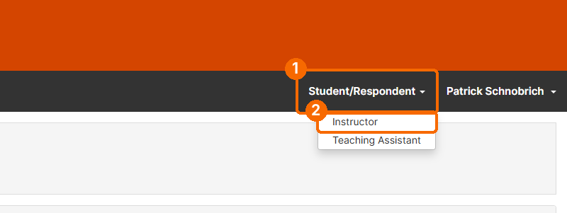
BEFORE YOU START · STEP 2
Switch to the Instructor role
Check your role in the top right corner. It must say Instructor. If it says Student/Respondent, click it and choose Instructor. The Custom Questions menu only appears in the Instructor role.
Notes:
Look at the top right corner. It should say Instructor. If it says Student or Respondent, click it and choose Instructor. The Custom Questions menu only appears in the Instructor role.

Slide 6
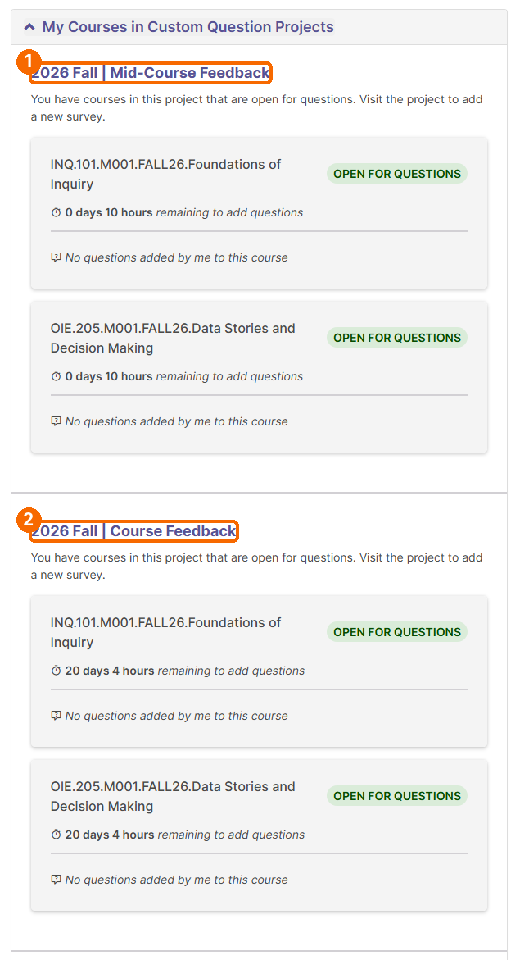
BEFORE YOU START · STEP 3
Find your courses on the Home page
On your Home page, look at the My Courses in Custom Question Projects box. It lists each course that is Open for Questions, how much time you have left to add questions, and how many questions you have added so far. This box is the quickest way to see which project is open for you right now.
Tip: If you do not see this box, or your course is not listed, the window for adding questions may not be open yet. Contact coursefeedback@syr.edu.
Notes:
On your Home page, find the box called My Courses in Custom Question Projects. It shows each course that is open for questions, how much time you have left, and how many questions you have added.

Slide 7
Part 1: Build Your Survey
Choose Item Bank questions, write your own, or both
Notes:
Part one. Build your survey.

Slide 8
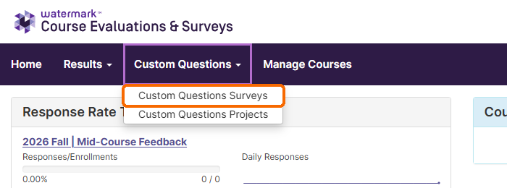
PART 1 · STEP 1
Open Custom Questions Surveys
In the purple menu bar, click Custom Questions, then Custom Questions Surveys.
Notes:
In the menu bar, click Custom Questions, then Custom Questions Surveys.

Slide 9
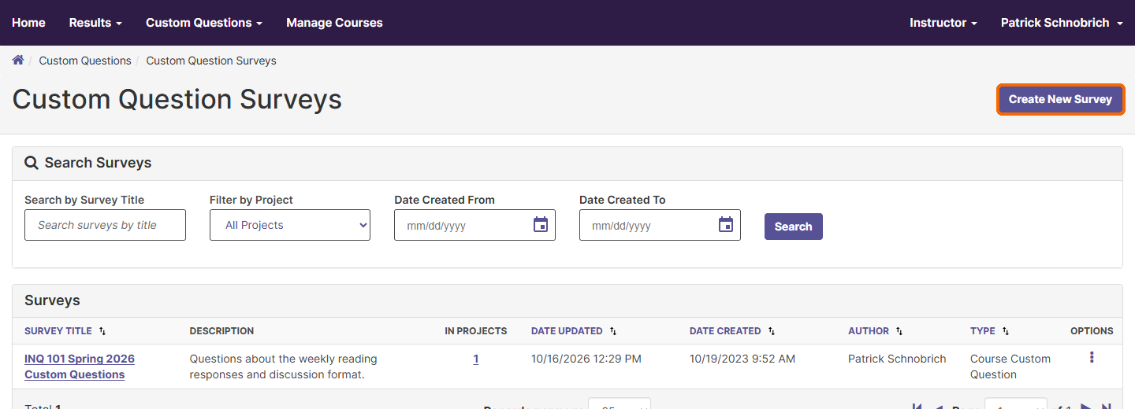
PART 1 · STEP 2
Create a new survey
Click Create New Survey in the top right corner. Any surveys you built in past terms are listed here too.
Tip: Reusing a survey from a past term? Click the three-dot Options menu next to it and choose Create a Copy, or Edit to change it. Clicking a survey's title only opens a preview.
Notes:
Click Create New Survey in the top right corner. If you built a survey in a past term, you can reuse it. Open its options menu and choose Create a Copy.

Slide 10
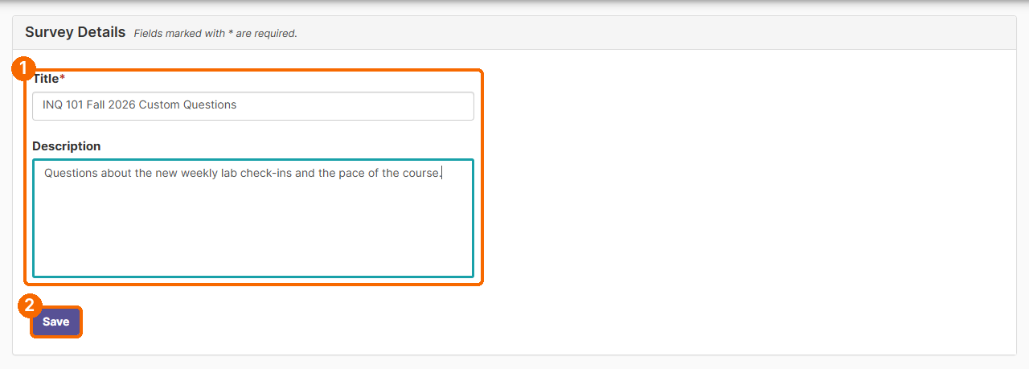
PART 1 · STEP 3
Name your survey
Enter a Title (required) and an optional Description, then click Save. Students do not see the title or description, so pick a name you will recognize later, such as "INQ 101 Fall 2026 Custom Questions."
Notes:
Type a title and an optional description, then click Save. Students do not see the title, so choose a name you will recognize later.

Slide 11
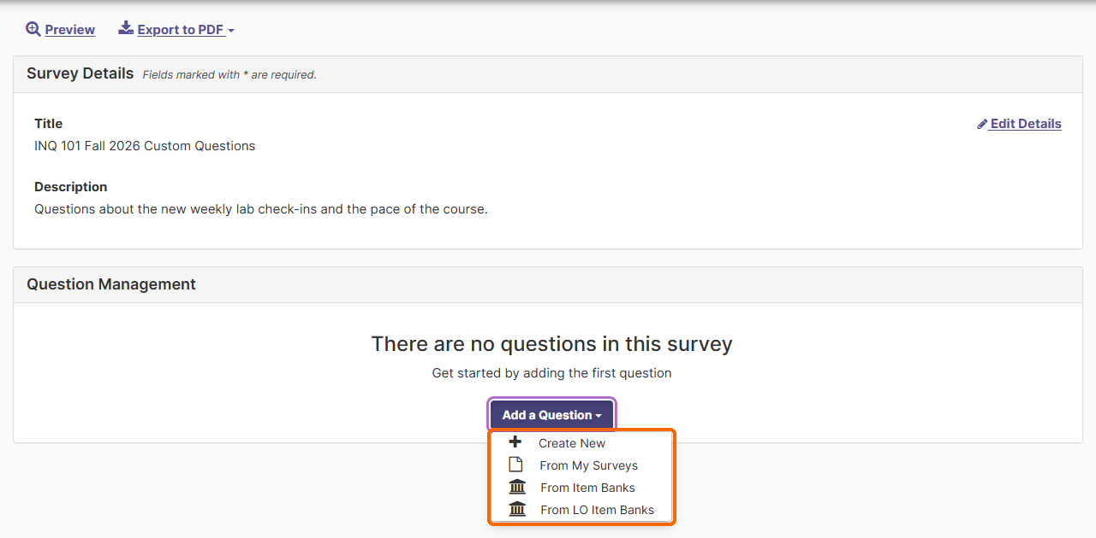
PART 1 · STEP 4
Choose how to add questions
Click Add a Question. You will see four choices. Use the one that matches what you want to do:
Notes:
Click Add a Question. You will see four choices.

Slide 12
PART 1 · STEP 4
Four ways to add questions
Choice | Use it to
Create New | Write your own question from scratch (Path C below).
From My Surveys | Reuse questions you already wrote in another one of your surveys.
From Item Banks | Choose from OIE's ready-made question sets, organized by topic (Paths A and B below).
From LO Item Banks | Not used at Syracuse. Skip this one.
Notes:
Create New lets you write your own question. From My Surveys reuses questions you wrote before. From Item Banks lets you choose ready-made questions by topic. You can skip From L O Item Banks. It is not used at Syracuse.

Slide 13
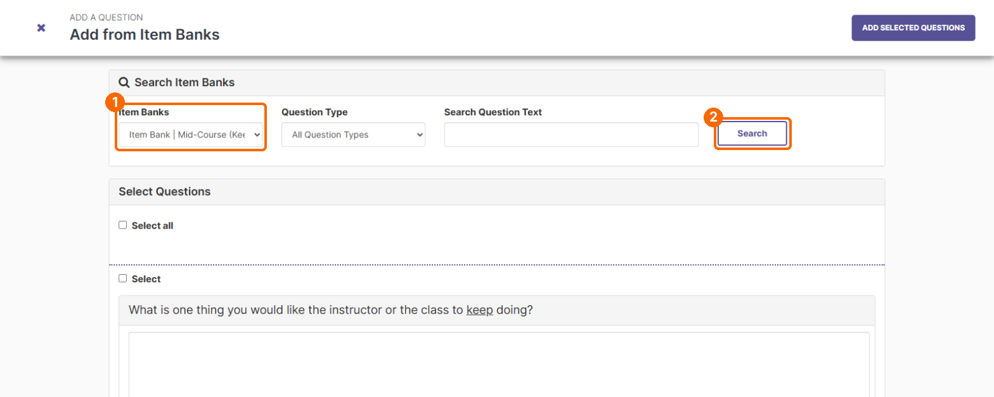
PATHS A AND B · ITEM BANKS · 1
Pick one Item Bank
From the Item Banks dropdown, choose one bank, then click Search. The page starts on All Item Banks, which mixes every bank's questions together, so always choose a bank first.
Tip: Looking for something specific? Type a word in Search Question Text (for example, "exam") or filter by Question Type, then click Search.
Notes:
To use an Item Bank, choose one bank from the dropdown, then click Search. The page starts on All Item Banks, so always pick a single bank first.

Slide 14
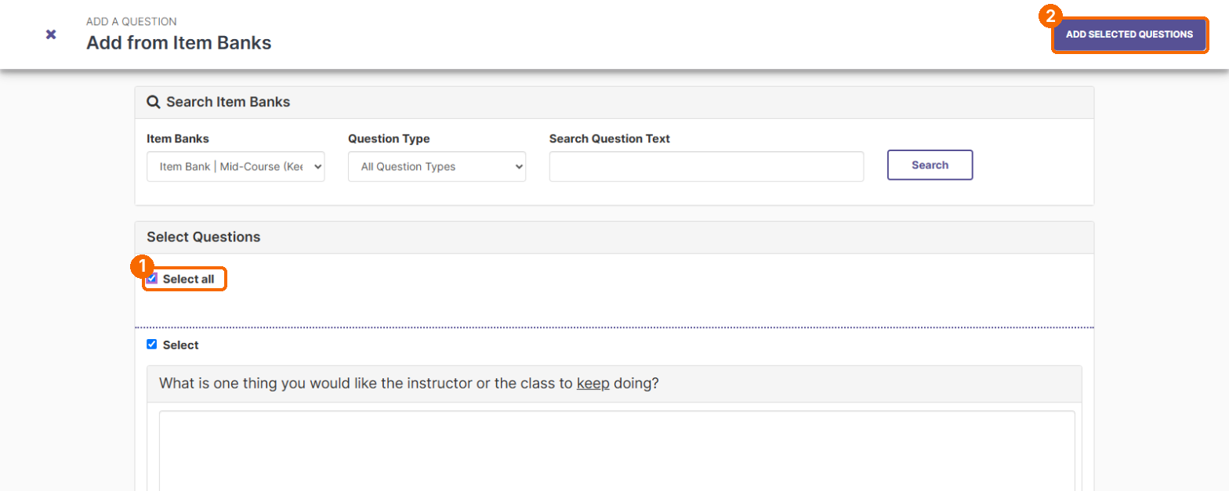
PATHS A AND B · ITEM BANKS · 2
Use the whole bank
To use the whole bank, check Select all. Then click Add Selected Questions in the top right corner.
Tip: Only use Select all after you have chosen a single bank. With All Item Banks showing, it would add every question from every bank.
Notes:
To use every question in that bank, check Select all, then click Add Selected Questions.

Slide 15
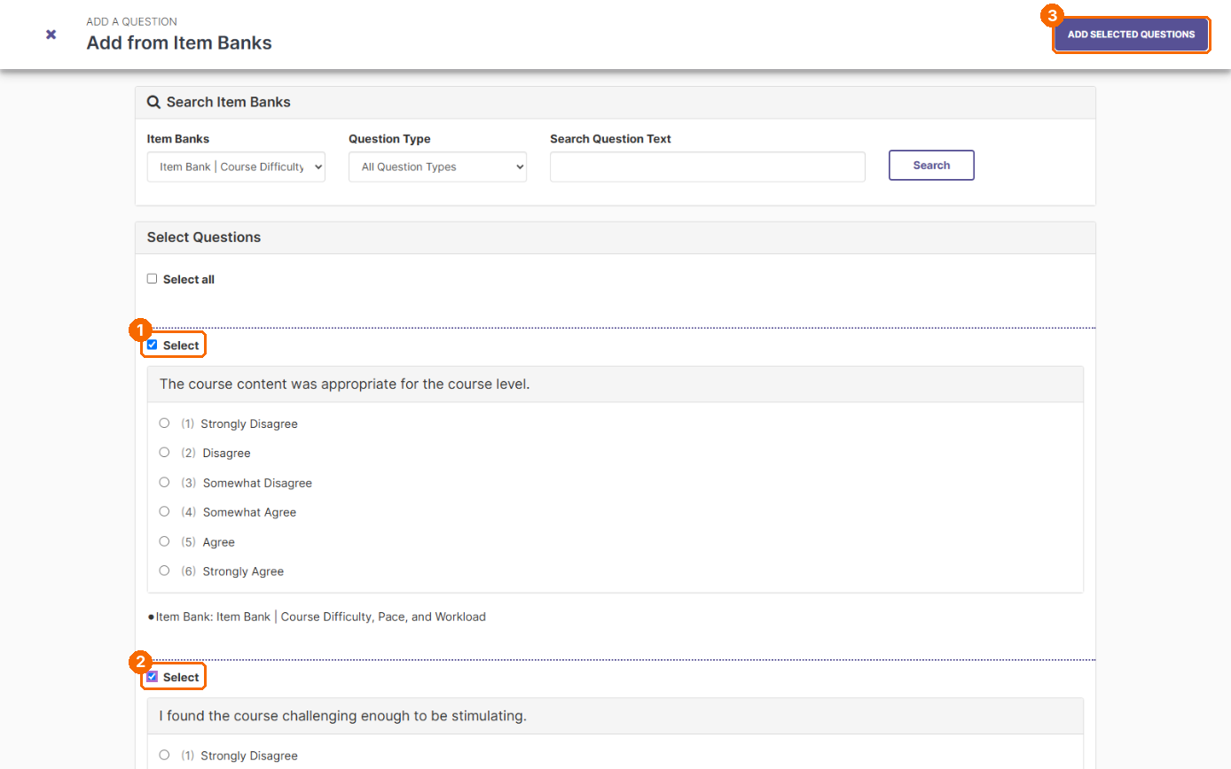
PATHS A AND B · ITEM BANKS · 3
Or pick only some questions
To use only some questions, check Select above each question you want instead, then click Add Selected Questions.
Notes:
To use only some questions, check Select above each one you want, then click Add Selected Questions.

Slide 16
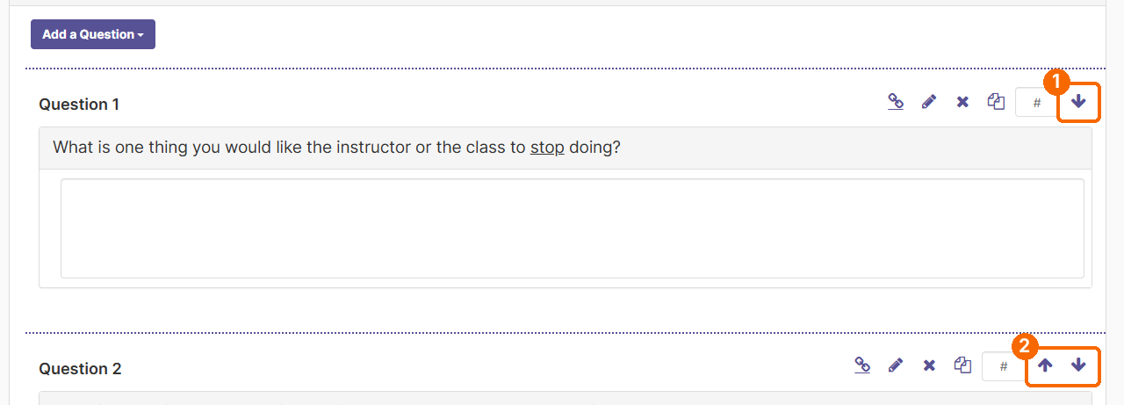
PATHS A AND B · ITEM BANKS · 4
Review and reorder
You are returned to your survey with the questions added. Questions are not always added in the same order as the bank, so check the order. To add questions from another bank, click Add a Question and repeat.
Tip: The chain-link icon marks a question that came from an Item Bank.
Notes:
You return to your survey with the questions added. They are not always in the same order as the bank, so check the order. To add more questions, click Add a Question again.

Slide 17
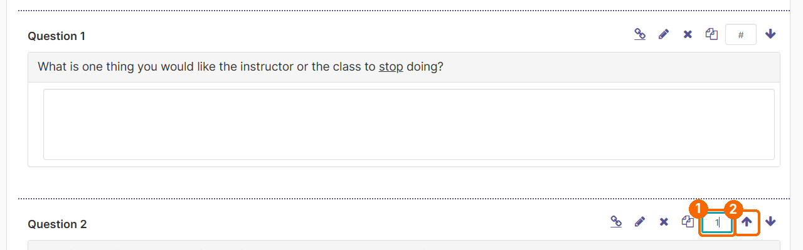
PATHS A AND B · ITEM BANKS · 5
Move a question
To move a question, type how many spots to move it in the small # box next to the arrows, then click the up or down arrow. For example, type 1 and click the up arrow to move a question up one spot.
Tip: If you click an arrow while the # box is empty, you will see a "Move number is required" message. Type a number in the box first.
Notes:
To move a question, type how many spots to move it in the small box next to the arrows. Then click the up or down arrow. For example, type 1 and click the up arrow to move it up one spot.

Slide 18
PATHS A AND B · ITEM BANKS
Mid-course Item Banks
Popular choices for a quick check-in with students:
Item Bank | What it covers
Mid-Course (Various Questions) | A range of items for checking in with students partway through the term.
Mid-Course (Working, Not Working, Suggestions) | Open-ended: what is working, what is not, and what students suggest.
Mid-Course (Keep, Stop, Start) | Open-ended: what to keep doing, stop doing, and start doing.
Tip: These banks were written for mid-semester check-ins, but you can use them on your end-of-course survey too. Check the wording first: a question about the course "so far" may read oddly at the end of the term.
Notes:
If you want a quick check-in with students, the mid-course Item Banks are a good place to start. You can use them at the end of the term too. Just check the wording first.

Slide 19
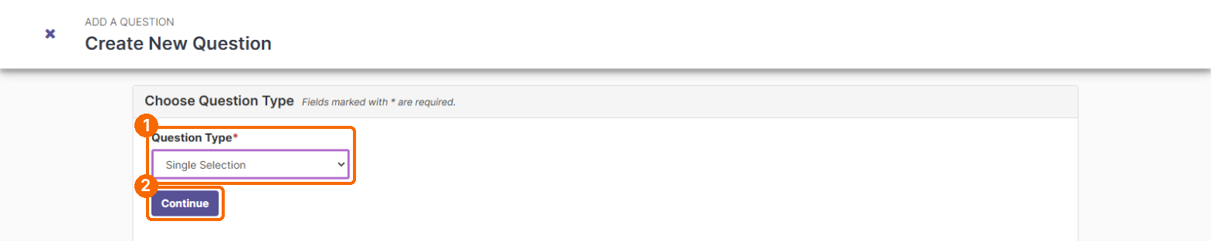
PATH C · WRITE YOUR OWN · 1
Choose a question type
Click Add a Question, then Create New. Choose a Question Type and click Continue.
Notes:
To write your own question, click Add a Question, then Create New. Choose a question type and click Continue.

Slide 20
PATH C · WRITE YOUR OWN
Question types
Type | What students see
Single Selection | Students pick one answer. Best for agree/disagree scales and yes/no.
Multiple Selection | Students check all that apply.
Matrix | Several statements that share the same answer scale, shown as a grid.
Numeric Selection | Students choose a number on a scale.
Write-in | Students type an open-ended response.
Label | Text or instructions only. No answer is collected.
Notes:
Single Selection lets students pick one answer, like an agree or disagree scale. Multiple Selection lets them check all that apply. Matrix shows several statements on the same scale. Numeric Selection asks for a number. Write-in collects a typed comment. And a Label adds text or instructions, with no answer.

Slide 21
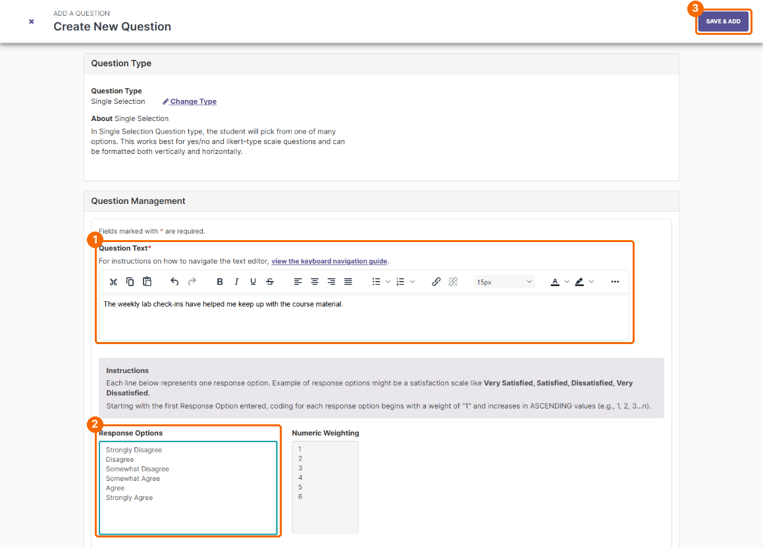
PATH C · WRITE YOUR OWN · 2
Write your question
Type your question in Question Text. For choice-type questions, enter one answer option per line in Response Options. The system numbers them automatically (1, 2, 3...). Click Save & Add in the top right corner when finished.
Tip: For agreement questions, OIE recommends the 6-point scale shown here: Strongly Disagree, Disagree, Somewhat Disagree, Somewhat Agree, Agree, Strongly Agree. Save & Add is at the top of the page, so scroll back up if needed.
Notes:
Type your question. Then enter your answer choices, one per line. For agreement questions, we recommend the six-point scale, from Strongly Disagree to Strongly Agree. When you are finished, click Save and Add at the top of the page.

Slide 22
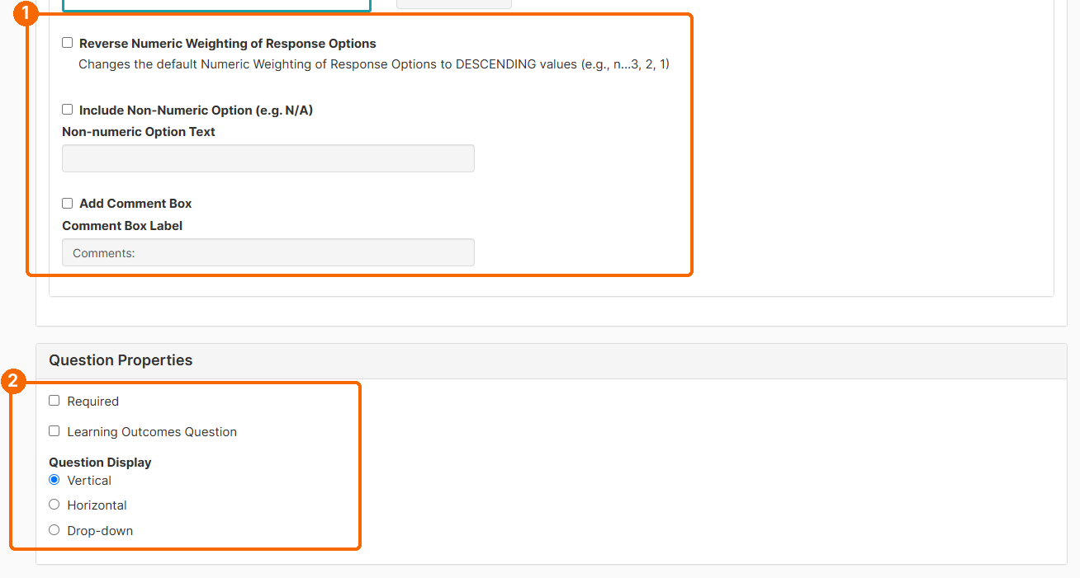
PATH C · WRITE YOUR OWN · 3
Optional settings
Optional settings are below the answer options: reverse the numbering, add an N/A choice, add a comment box, mark the question Required, and choose a vertical, horizontal, or drop-down layout. Leave Learning Outcomes Question unchecked.
Notes:
Below the answer choices are optional settings. You can add an N A choice, add a comment box, or make the question required. Leave Learning Outcomes Question unchecked.

Slide 23
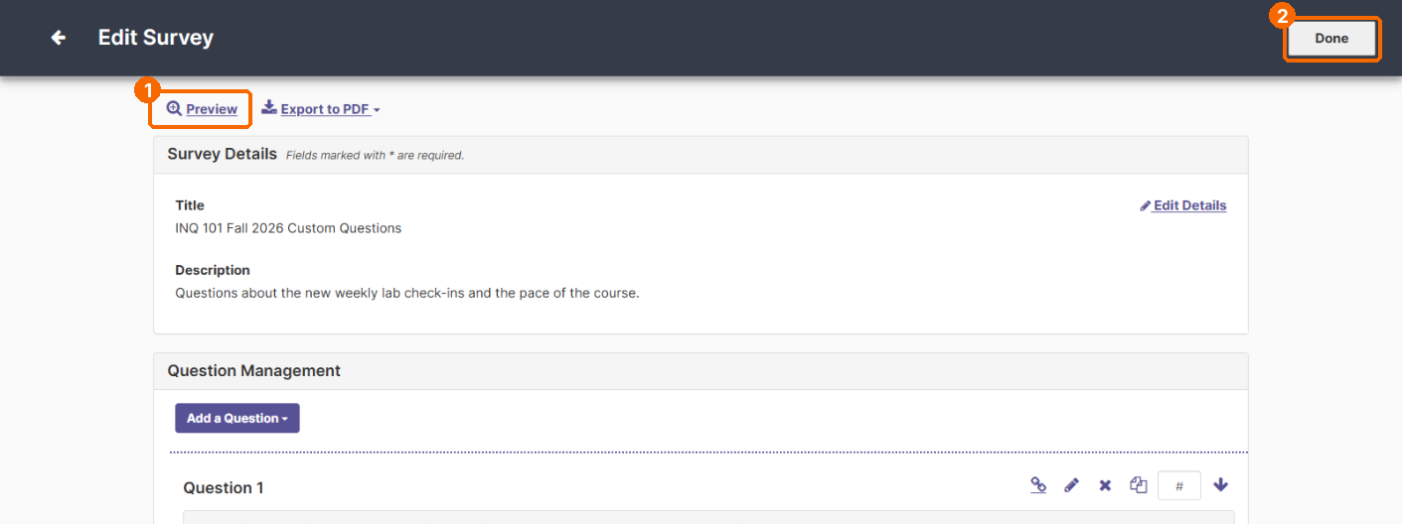
FINISH PART 1 · 1
Preview, then click Done
Review your questions. Use the pencil to edit a question and the X to delete one. Click Preview to see the survey as students will, then click Done.
Notes:
Review your questions. Click Preview to see the survey the way students will. Then click Done.

Slide 24
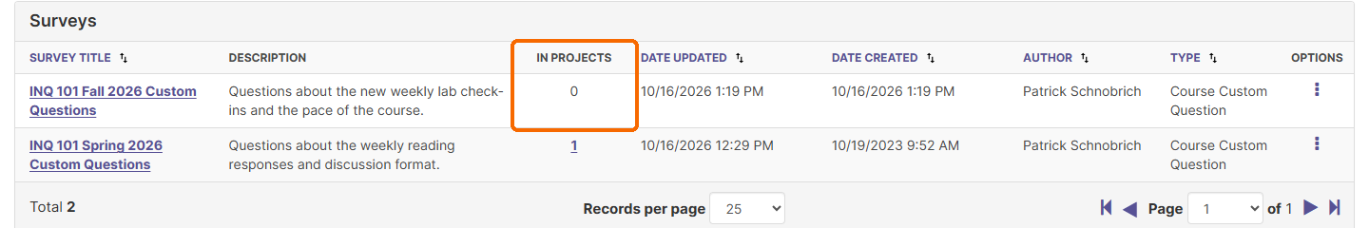
FINISH PART 1 · 2
Built, but not attached yet
Back on the Custom Question Surveys list, your survey shows 0 under In Projects. That is expected: it is built but not attached yet. Continue to Part 2.
Notes:
Back on your survey list, you will see a zero under In Projects. That is expected. Your survey is built, but it is not attached to a course yet.

Slide 25

Part 2: Attach Your Survey
Nothing reaches students until your survey is attached
Notes:
Part two. Attach your survey to your courses.

Slide 26
PART 2 · STEP 1
Open your project from Home
Go to your Home page. In the My Courses in Custom Question Projects box, click the name of the project you want to add questions to (for example, 2026 Fall | Course Feedback). This opens the project page. A project is the system's name for one term's course feedback.
Tip: Only add questions to a project whose courses say Open for Questions. If two projects are listed, check that you are choosing the one you mean, such as end-of-course feedback rather than mid-course feedback.
Notes:
Go to your Home page. In the My Courses in Custom Question Projects box, click the name of the project you want. This opens the project page. A project is the system's name for one term's course feedback. If two projects are listed, make sure you pick the right one.

Slide 27
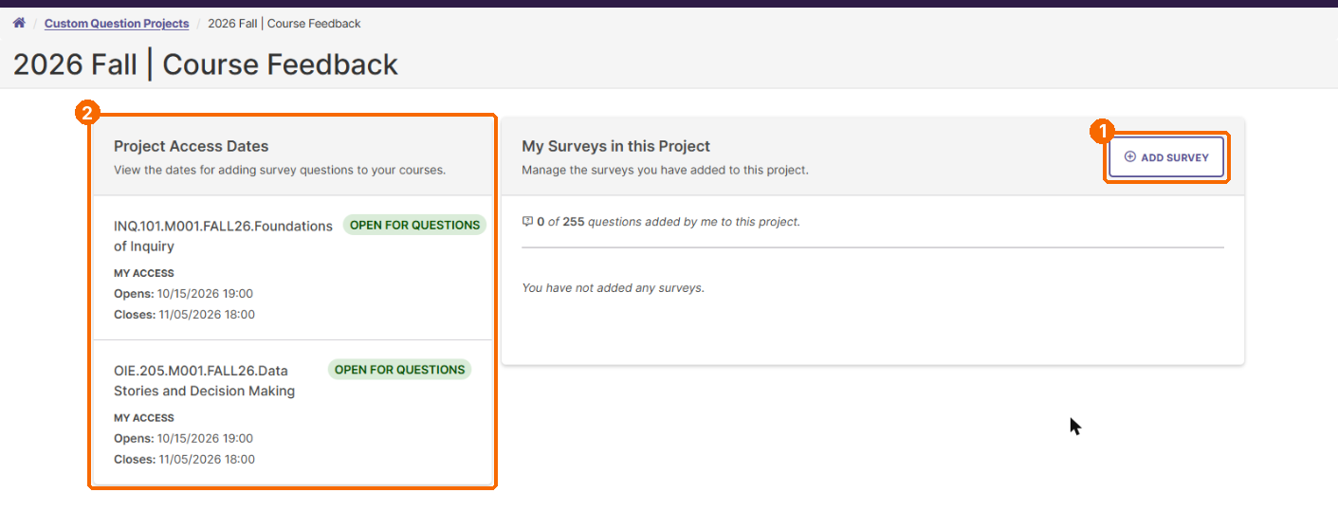
PART 2 · STEP 2
Click Add Survey
On the project page, check Project Access Dates on the left to see when each course opens and closes for questions. Then click Add Survey on the right.
Notes:
On the project page, you can see the dates your course is open for questions. Click Add Survey.

Slide 28
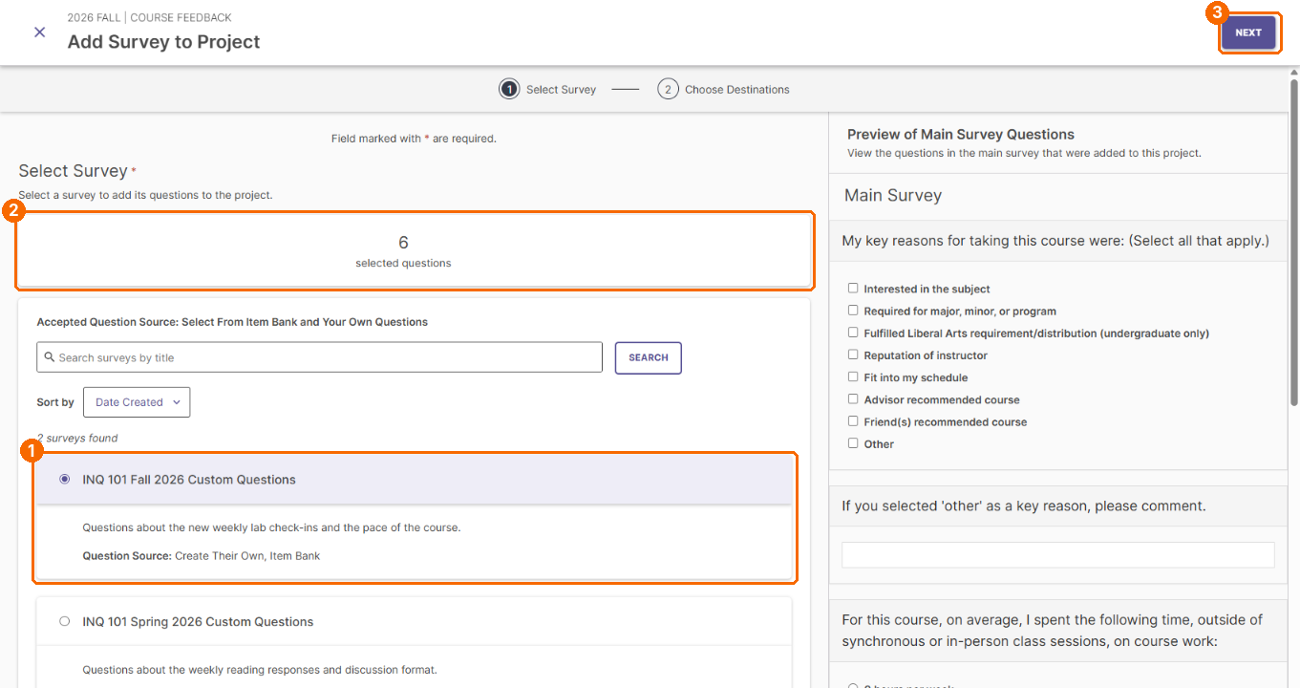
PART 2 · STEP 3
Select your survey
Step 1, Select Survey: click the circle next to your survey. The counter confirms how many questions it contains. Click Next.
Tip: The panel on the right previews the Main Survey questions your students will already see. Scan it so you do not ask the same thing twice.
Notes:
Select your survey and click Next. The panel on the right shows the questions your students will already see, so you can avoid asking the same thing twice.

Slide 29
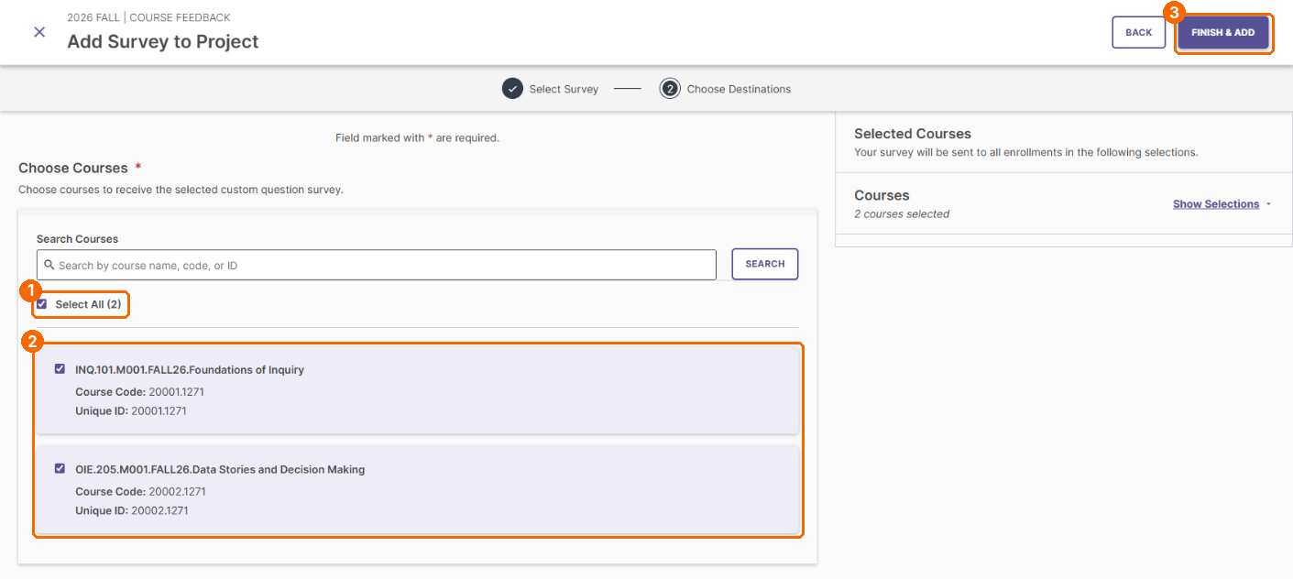
PART 2 · STEP 4
Choose your course(s)
Step 2, Choose Destinations: check each course that should receive your questions, or check Select All. If you teach many sections, use Search Courses. Click Finish & Add.
Tip: Your questions go to every student enrolled in the courses you check.
Notes:
Check each course that should get your questions, then click Finish and Add. Your questions go to every student enrolled in those courses.

Slide 30
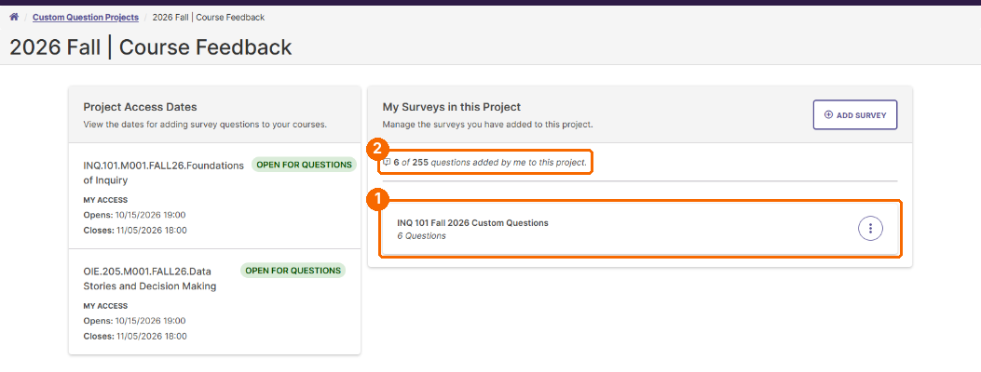
PART 2 · STEP 5
Confirm it was added
Your survey now appears under My Surveys in this Project with its number of questions, and the count at the top goes up.
Notes:
A confirmation appears, and your survey is listed in the project with its number of questions.

Slide 31
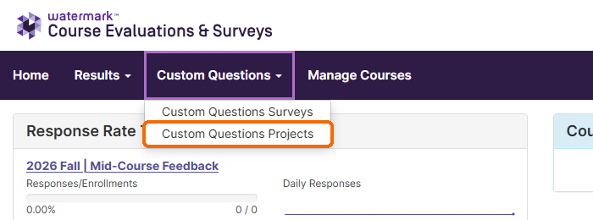
ANOTHER WAY TO OPEN A PROJECT · 1
Open Custom Questions Projects
You can also reach your projects from the menu bar: click Custom Questions, then Custom Questions Projects.
Notes:
You can also reach your projects from the menu bar. Click Custom Questions, then Custom Questions Projects.

Slide 32
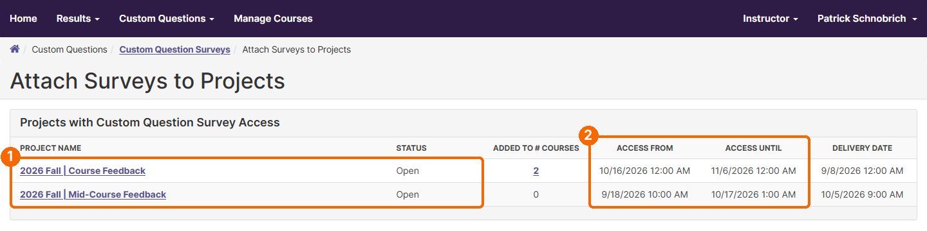
ANOTHER WAY TO OPEN A PROJECT · 2
Pick the open project
On the Attach Surveys to Projects page, click the project whose Status says Open. The Access From and Access Until columns show the window for adding questions.
Notes:
Then click the project whose status says Open. The access columns show the window for adding questions.

Slide 33
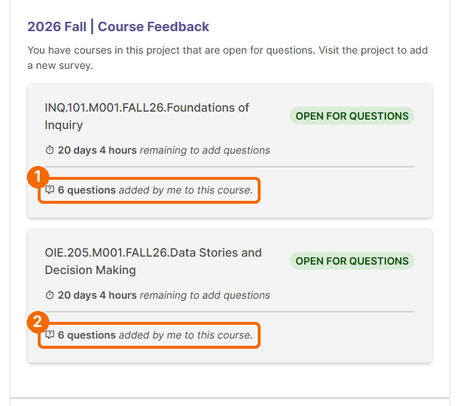
CONFIRM IT WORKED · 1
Check your Home page
Return to your Home page. The My Courses in Custom Question Projects box now shows how many questions you added to each course. If it still says no questions, repeat Part 2.
Notes:
To double check, go back to your Home page. The box now shows how many questions you added to each course.

Slide 34
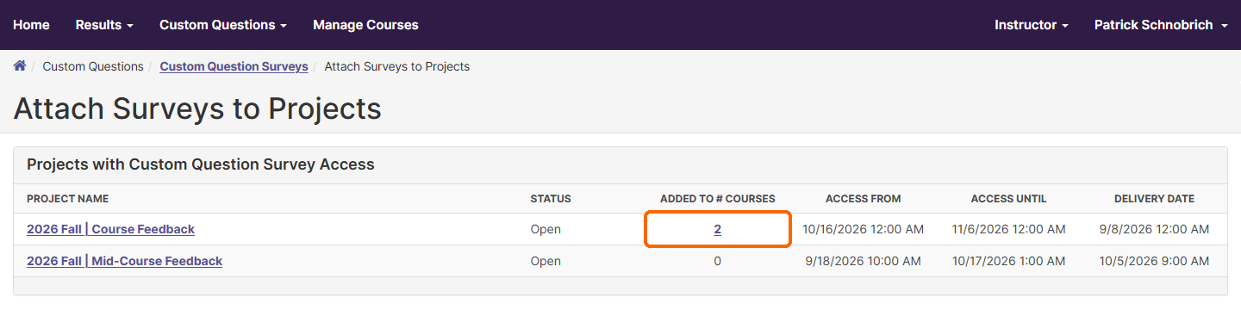
CONFIRM IT WORKED · 2
Check the project list
You can also check the Attach Surveys to Projects page (Custom Questions, then Custom Questions Projects). The Added to # Courses column shows how many of your courses received the survey.
Notes:
You can also check the project list. The Added to number of Courses column shows how many of your courses received the survey.

Slide 35
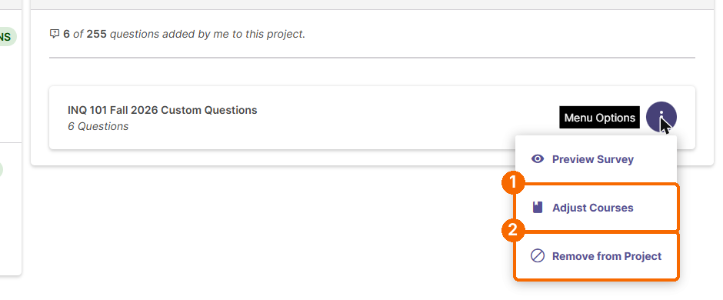
MAKING CHANGES LATER · 1
Adjust or remove a survey
To change which courses get the survey, or to remove it, open the project (Part 2, step 1) and click the three-dot menu next to your survey: Preview Survey, Adjust Courses, or Remove from Project.
Tip: Adjust Courses changes which courses get the survey. Remove from Project takes it off every course in this project at once.
Notes:
To make changes later, open the project and use the menu next to your survey. Adjust Courses changes which courses get it. Remove from Project takes it off all of them.

Slide 36
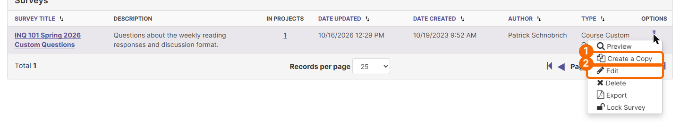
MAKING CHANGES LATER · 2
Edit or copy a survey
To change the questions themselves, go to Custom Questions Surveys, click the three-dot Options menu next to the survey, and choose Edit.
Notes:
To change the questions themselves, go to Custom Questions Surveys, open the options menu next to your survey, and choose Edit.

Slide 37
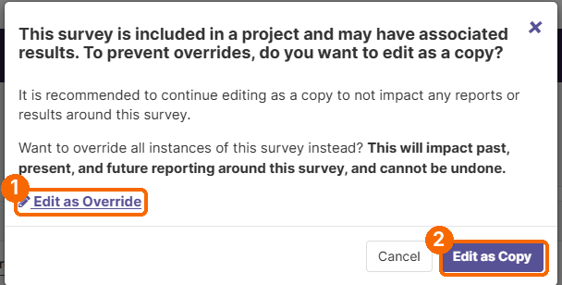
MAKING CHANGES LATER · 3
Edit as a copy or override
If the survey is already attached to a project, a message asks how you want to edit it. Choose Edit as Copy to make a new version and leave the original, and its results, unchanged. Choose Edit as Override only if you want to change the survey everywhere it is used.
Tip: Edit as Override changes past, present, and future reports for that survey and cannot be undone. If you edit as a copy, attach the new copy to your course in Part 2.
Notes:
If the survey is already attached to a project, you will be asked how to edit it. Edit as Copy makes a new version and leaves the original and its results alone. Edit as Override changes the survey everywhere it is used, including past reports, and cannot be undone. If you edit a copy, attach it to your course in Part 2.

Slide 38
Questions?
Office of Institutional Effectiveness
coursefeedback@syr.edu
Notes:
That's it. If you have questions, contact the Office of Institutional Effectiveness at coursefeedback at s-y-r dot e-d-u.

