Slide 1
Welcome to Ready, Set, Rubric
Get Settled and Grab Lunch
Discussion will begin at 12:40

Slide 2
Ground Rules
One person speaks at a time
Engage in respectful dialogue
Promote authentic conversations – safe space to speak freely
Listen to understand, not to respond
Trust one another’s experiences
Share concerns or challenges with the group – challenge the idea not the person
Equal participation – be mindful to let others speak
Ask questions; avoid statements

Slide 3
Benefits of Rubrics
For students, rubrics:
clarify the instructor’s expectations regarding the assignment,
provide criteria for achieving learning objectives, and
can be used as a guide when developing their assignment.
For faculty, rubrics:
can be used to assess any criteria or behavior;
help to make the grading process quicker, fairer, and more transparent;
allow for consistent grading, from the first assignment through the very last; and
serve as a reliable grading scale.

Slide 4
Types of Rubrics
Analytic Rubrics - today’s focus
An analytic rubric breaks down the objective into specific component parts. Every section is scored independently using a rating scale.
Developmental Rubrics
Developmental rubrics are closely related to analytic rubrics to the extent that they also measure skill based on a weighted system.
Holistic Rubrics
A holistic rubric is made up of a single scale with all criteria to be considered together.

Slide 5
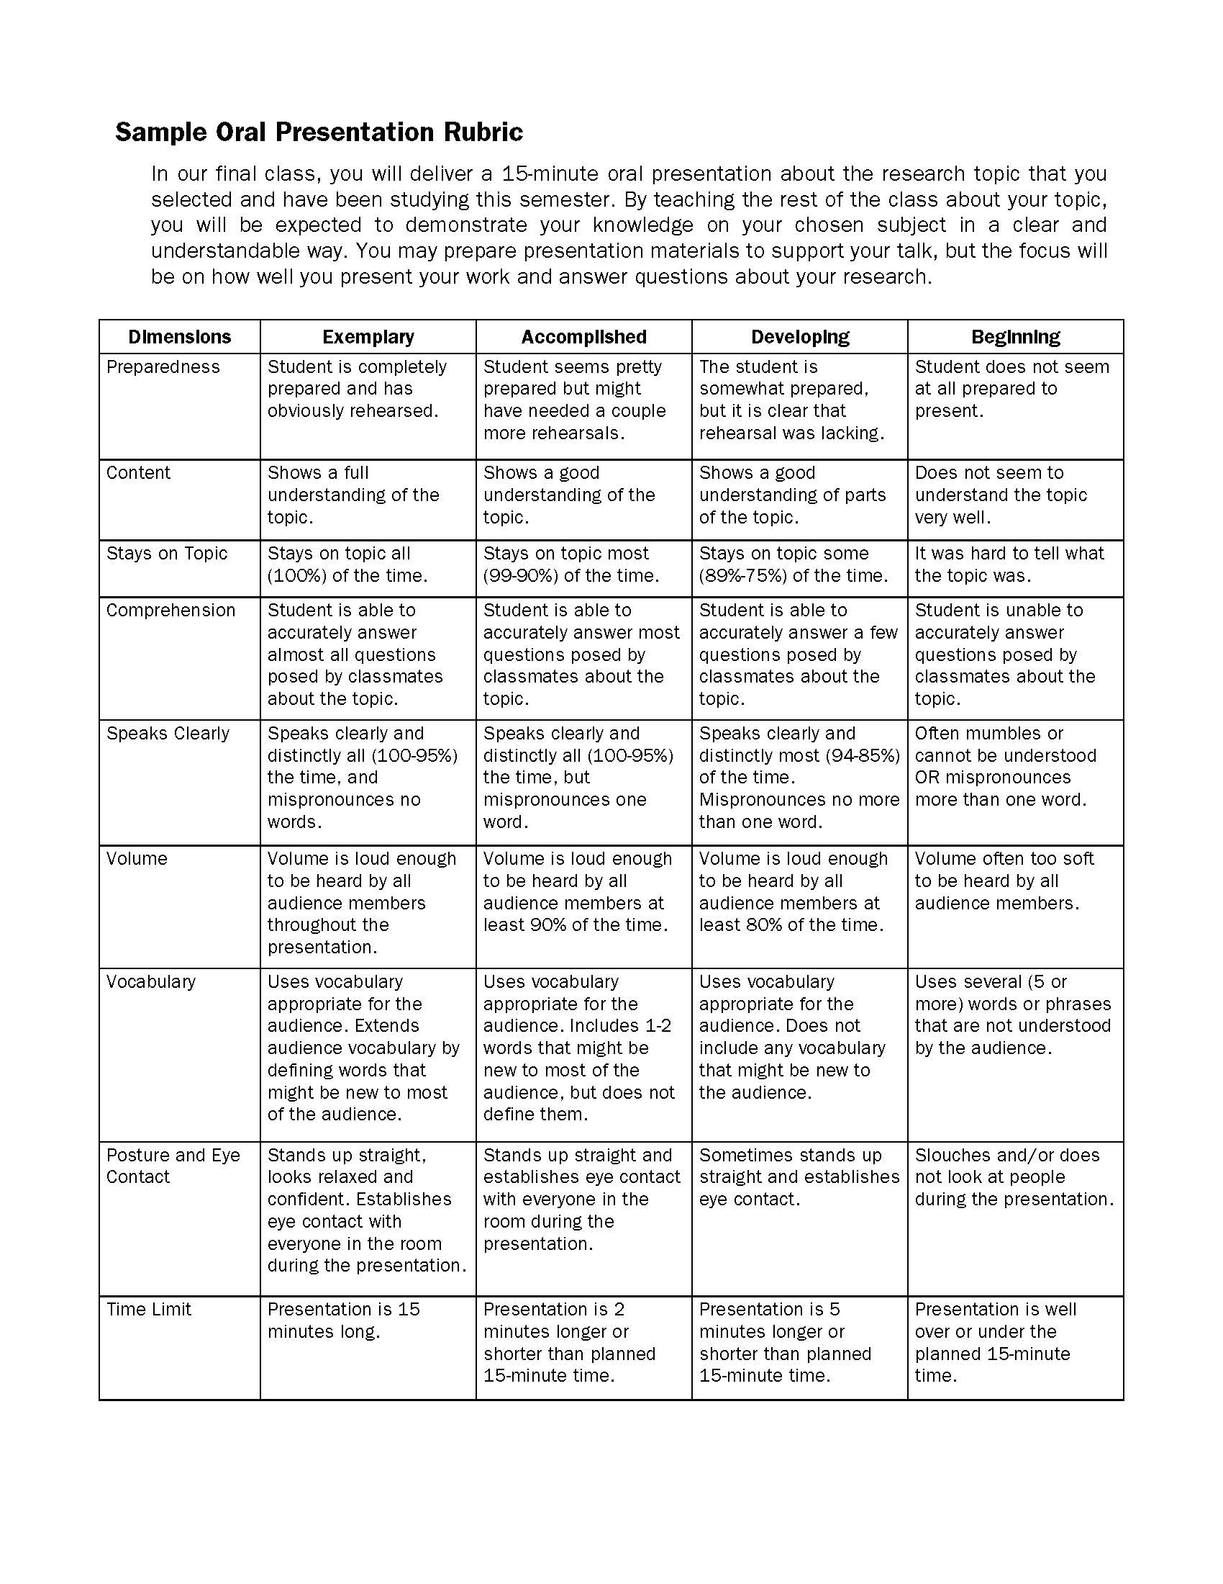
Parts of Rubrics
1. Task Description
What is the assignment?
2. Scale
What are the levels of achievement?
3. Dimensions of the Assignment
What is the breakdown of the skills/knowledge involved?
4. Performance Level Descriptions
What specific feedback can be given for each level of each dimension?

Slide 6
Class Participation Rubric
Reflect
Individually, reflect on aspects of student participation in the classroom.
Consider:
What has worked in the past to elicit good participation?
What doesn’t work?
What is the best way to participate in class?
What do you observe (see or hear) when a student is participating well in class?

Slide 7
List
On separate sticky notes, jot down descriptive words that communicate what an excellent class participant does.
The fewer the words, the better.
Each person creates 10 sticky notes.

Slide 8
Group and Label
Each group member adds their sticky notes to the large post-it sheet.
Work together to cluster similar ideas, creating 3-7 clusters.
Using the markers, label each cluster.
What kind of sticky notes are in the group?
A label consists of 1-2 words.
Labels will become the rubric dimensions.

Slide 9
Apply
Select a 3-point scale from page 6 of the Rubric Roadmap.
Create performance level descriptions.
Sticky notes are the beginnings of the highest performance level.
Continue to create the rest of the descriptions, starting with the lowest performance level (then fill in the middle).
Learn more: How to turn sticky notes into descriptions
https://www.youtube.com/watch?v=NVHlbRsjA10

Slide 10
Class Participation Debrief
What was easy about this exercise?
What was challenging?
What did you notice about other rubrics?
What questions emerged?

Slide 11
Rubric Roadmap
Create a rubric for your own assignment:
Prepare a clear task description for students (see page 5 of the Rubric Roadmap).
Develop the rubric by working through the four stages:
Reflect
List
Group and label
Apply
Review the finished rubric to evaluate its overall quality; the meta rubric on page 8 of the Rubric Roadmap can be used to do this.

Slide 12
Thank You for coming to Ready, Set, Rubric
Center for Teaching and Learning Excellence
Martha Diede - Director - madiede@syr.edu
Nicholas Bennett - Program Support Coordinator - nsbennet@syr.edu
http://provost.syr.edu/center-for-teaching-and-learning-excellence/
Institutional Effectiveness and Assessment
Laura Harrington - Associate Director - lalvut@syr.edu
Amanda Johnson Sanguiliano - Assessment Associate - aljohn07@syr.edu
http://assessment.syr.edu/

