Slide 1
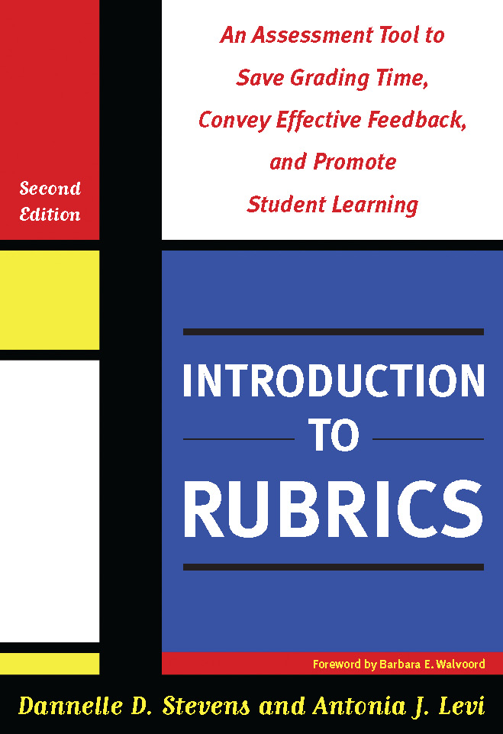
Rubrics: A powerful assessment tool for you, your students & your programs
Dannelle D. Stevens, Ph.D.
Professor Emerita, Portland State University
Syracuse University, Syracuse, NY
September 24, 2016
stevensd@pdx.edu

Slide 2
Introductions
Me: Professor, author, grandma, gardener, cyclist
You? Name
University for advanced degree
Name a hobby or sport you practice.
PRACTICE.. Precision practice

Slide 3
Overall Workshop Objectives: AM, Creating Classroom Rubrics
Open the door to
Creating meaningful rubrics for you, your class and your teaching
Seeing how rubrics develop expertise through timely, precise feedback

Slide 4
Agenda
Discuss assessment
Define rubrics an assessment tool
Practice stages of rubric construction
Match rubrics to course goals
Understand long-range benefits of rubrics

Slide 5
Assessment challenges: Students
Not sure grades fairly determined
Face unfamiliar words in assignments
Feel confused….
Lowers motivation
Lowers persistence
Learn less

Slide 6
Assessment Challenges: Faculty
Need to remove subjectivity in grading
Establish standards but not remove creativity
Tired of lengthy grading time
LEADS TO
Increased FRUSTRATION
lowered MOTIVATION
---- questioning STUDENT LEARNING

Slide 7
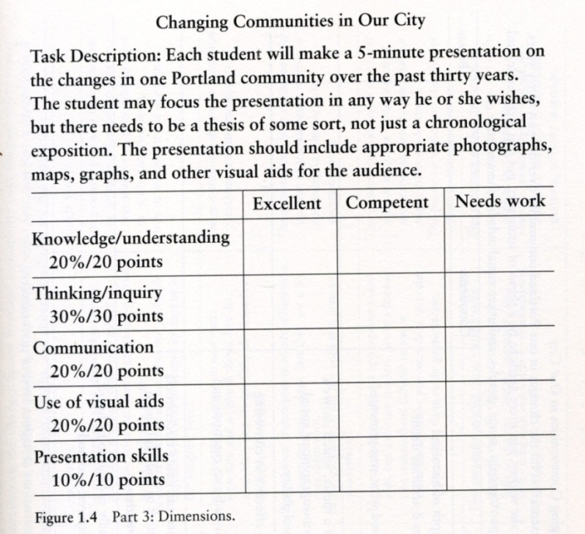
What is a rubric?
A rubric is a way to measure whether students met your objectives
It is a full description of the assignment or task laid out on a grid.

Slide 8
Parts of a rubric
A rubric has 4 basic parts:
TASK DESCRIPTION from syllabus
DIMENSIONS or CRITERIA
Vertical list to the right
SCALE or levels of performance
Horizontal across top of grid
DESCRIPTION OF DIMENSIONS
Within the grid aligned with dimensions & scale

Slide 9
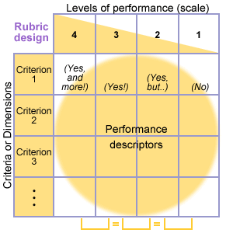
Example of rubric parts
Task description
Dimensions (Criteria)
Levels of performance
Descriptions of
performance

Slide 10
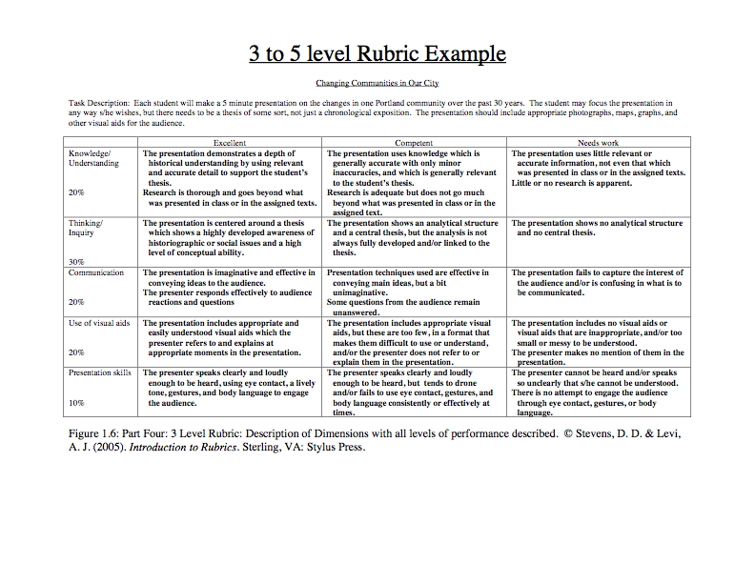
A rubric: 3-levels

Slide 11
The Four Stages of Rubric Construction
Reflecting
Listing
Grouping & Labeling
Application

Slide 12
Start with a rich task description: Create a description of class participation
Name of the assessment:
Class participation
Dimensions of assessment
Title of assessment for rubric
Purpose of assessment
Relation of score to overall points

Slide 13
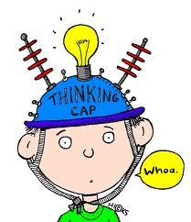
Stage 1: Reflect
Think about all aspects of class participation, in and out of class…
What has worked to get good
participation in past?
What doesn‘t work?
How does it fit in curriculum?
How would you describe the
most perfect way to participate
in class?

Slide 14
Stage 1: REFLECT
She shows up.
She turns in her work on time.
She raises her hand.
She has good grades.
She asks good questions.
She asks interesting questions.
Questions to ask yourself:
What does a good participant do?
What makes you say this is the best student participant in your class?
What do you see? Hear?

Slide 15
Stage 2: Listing
Usually we use stickies. Write descriptions down; don’t worry about sounding silly.
Describe. NOT enthusiastic, but raises hand, smiles...
One idea only per stickie
Describe highest level of performance
The fewer words, the better
Each person do 10 stickies.

Slide 16
Stage 2: LISTING
Puts name on paper.
Turns work in on time.
Raises hand.
Asks excellent questions.
Does more than expected.
Works with others calmly and politely.
Comes to office hours with questions……
DESCRIBE in detail what an excellent class participant does.
Use STICKIES.

Slide 17
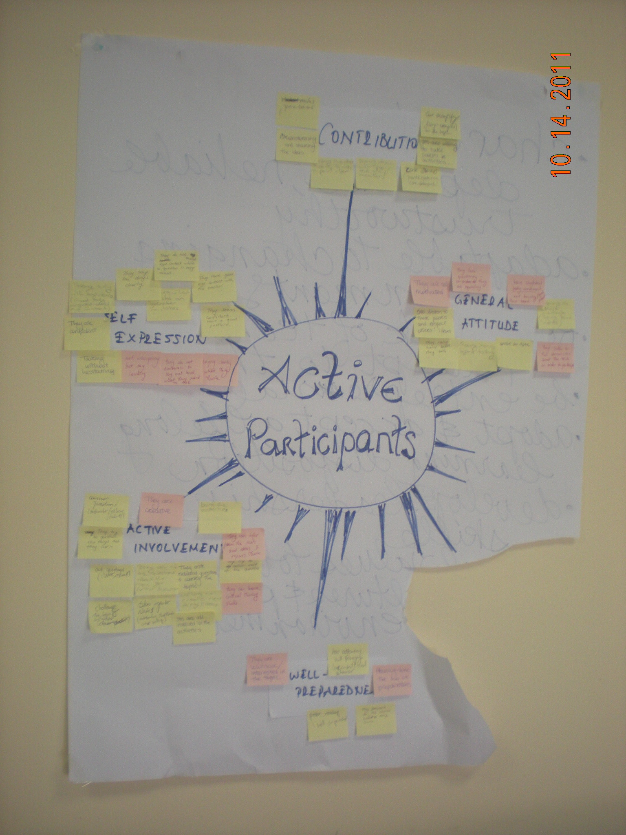
Stage 3: Grouping and Labeling
Move stickies around to GROUP or cluster similar ideas together.
Using 5” X 8” stickies OR thick pens, put one or two word LABELS on EACH cluster.
LABELS tell what kind of stickies are in the group.
Avoid evaluative words.

Slide 18
Stage III: GROUP & LABEL
TAKE THE STICKIES FROM THE LAST STEP.
Put stickies with similar ideas together.
Make label that describes the group.

Slide 19
Stage 3: Group & Label
No set way to cluster.
Labels: 3 to 7.
Labels: 1- 2 words
Labels: No quality indicators in the label.

Slide 20
Stage 4: Application
LABELS become
your rubric DIMENSIONS.
You have the beginning of dimension descriptions from all the stickie notes.

Slide 21
Application…

Slide 22
From stickies to descriptions
https://www.youtube.com/watch?v=NVHlbRsjA10
Check out the handout… Going from stickies to descriptions on rubric grid

Slide 23
Creating a rubric for an assignment in one of your courses!
Write description of task.
Follow the four steps for rubric creation!

Slide 24
The Four Stages of Rubric Construction
Reflecting
Listing
Grouping & Labeling
Application

Slide 25
Review: Known to the NEW!
Describe a familiar task….Known
Use the stages of rubric creation… New
Reflect
List
Group & Label
Apply

Slide 26
Value of rubrics: Students
Clarify academic language
Encourage engagement
Support critical thinking
(Peat, 2006)
Lead to perceptions
of fairness

Slide 27
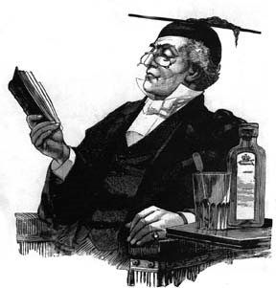
Value of rubrics: Faculty
Save grading time
Ensure consistency of grading/ fairness
Get specific feedback on teaching
Keep track of student learning
Facilitate communication
with others

Slide 28
Long range benefits: Students
Students identify strengths
Students identify weaknesses
Goal: Be able to describe and internalize criteria for quality work
.. REMEMBER HOW YOU BECAME BETTER AT YOUR SPORT OR HOBBY…. PRACTICE!
PRACTICE with feedback leads to....

Slide 29
What questions do you have?

Slide 30
Thank you so much….

